Slide 1
Essential Skills qualifications (NI)
(4800)

Slide 2




Where to find things…
Our principal web resources | Description
 | SmartScreen is our teaching and learning platform. Search for www.smartscreen.co.uk or link through any webpage.
 | Walled Garden is our secure administration portal – for registrations, entries, results, purchases, etc.
 | cityandguilds.com is our public website – qualification specifications, handbooks, assessment materials and other guidance.
 | Sign up at www.cityandguilds.com/updates to receive regular email alerts and updates. Be sure to select Maths and English and/or Essential Skills NI when asked for your preferences.

Slide 3

Navigating the cityandguilds.com site…
Go to cityandguilds.com/mathsandenglish, then click on the links to Northern Ireland
  The landing page contains an overview, with links to the Essential Skills (4800) webpage
  It also links to our ESOL Skills for Life (4692) suite.
  In the Quick Links box there are links to an updates page for all relevant NI qualifications.

Slide 4
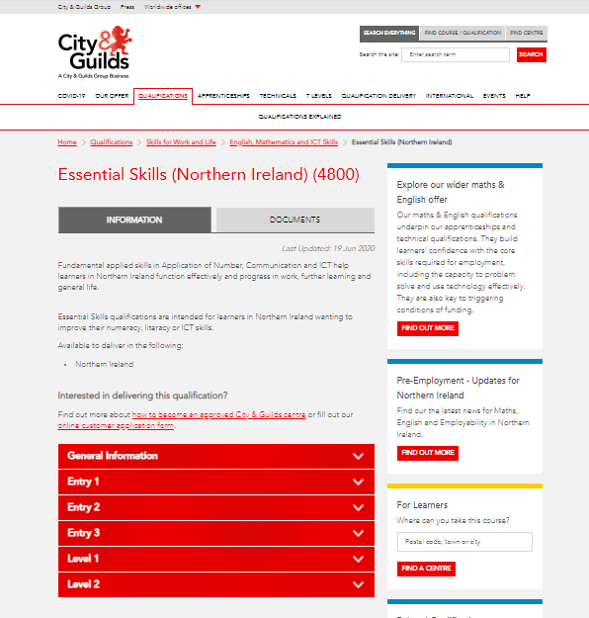
Locating the key information
Go to cityandguilds.com
Type in qualification number 4800 to find our Essential Skills NI qualification information and documents webpage.
Look out for the Information and Documents tabs at the top of the page.

Slide 5

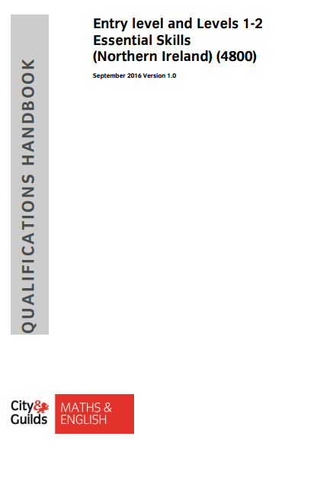
Key documents: curriculum vs qualification handbook
Essential Skills Standards and Curriculum
  Published by NI Department for the Economy (DfE).
  Sets out technical range of skills, knowledge and understanding expected at
  each level, with examples of contexts where these could be taught.
  Should underpin teaching of Essential Skills subject content.
Essential Skills Qualification Specifications
  Qualification/Subject Criteria devised by CCEA Regulation
    Common to all awarding organisations.
  Sets out skill standards, coverage and range Essential Skills
  qualifications must assess (as well as prescribing assessment model).
  Incorporated into our Essential Skills qualifications handbook.

Slide 6
Assessment model – in summary
Communication at levels 1 and 2
Reading/Writing: externally set and marked
  Single paper, with discrete Reading and Writing sections
Speaking & Listening: criterion-based internal assessment
  involving discussion, talk/presentation
ICT at levels 1 and 2
Portfolio assessment
Criterion-based, internally assessed
Adult Literacy at Entry level
Adult Numeracy at Entry level
externally-set, internally marked tasks
  Bank of tasks available to download from
  City & Guilds website
    password required for live tasks.
Application of Number at levels 1 and 2
Externally set and marked
  Single paper covering all skill standards

Slide 7
Remember: Essential Skills qualifications are a blend
Process skills
Technical skills

Slide 8
Key points to bear in mind:
  There is a new Instructions for Conducting Examinations (ICE) document available from the website.
  Level 1 and Level 2 exams are ‘On demand’ so that learners can take an assessment when they are ready
  All assessments are delivered in a paper-based format
  Essential Skills qualifications are concerned with the practical ability to apply communication and number skills within purposeful contexts.
  Less subject content than GCSE, but much more emphasis on applying knowledge/understanding.
  Scenario-based assessments – working through a ‘problem’ (and deciding what’s needed to tackle it).

Slide 9
Performance feedback
  External assessment results initially released to Walled Garden
  Hard copy confirmation sent a few days later, along with
    Notification of Candidate Results (NCR)
    Certificate (where due)
  As well as confirming grade, NCR also displays performance codes, indicating relative performance against each skill standard.
  A glossary of these codes can be found in the Essential Skills qualifications handbook (see pages 32-36).

Slide 10
Communication – Reading and Writing

Slide 11
Communication (Reading and Writing) – key points
Single assessment paper – with discrete Reading and Writing sections
  Level 1: 1 hour 30 minutes
  Level 2: 1 hour 45 minutes
Marked out of 50
  25 marks available for Reading (8 questions)
  25 marks available for Writing (2 documents)
Overall mark awarded for whole paper (no ‘internal threshold’ for each sub-skill)
Candidates need to manage their time!

Slide 12
Level 1: what’s being assessed?
Skill standard | Coverage and range | Mark allocation
Reading: Read and understand a range of straightforward texts. | Identify the main points and ideas and how they are presented in a variety of texts | 6-8
 | Read and understand texts in detail | 6-8
 | Utilise information contained in texts | 5-7
 | Identify suitable responses to texts | 5-7
 | In more than one type of text. | Two texts
Writing: Write a range of texts to communicate information, ideas and opinions using formats and styles suitable for their purpose and audience. | Write clearly and coherently, including an appropriate level of detail | 9 + 6
 | Present information in a logical sequence
 | Use language, format and structure suitable for purpose and audience
 | Use correct grammar, including correct and consistent use of tense | 10
 | Ensure written work includes generally accurate punctuation and spelling and that meaning is clear.
 | In more than one text type. | Two texts

Slide 13
Level 2: what’s being assessed?
Skill standard | Coverage and range | Mark allocation
Reading: Select, read, understand and compare texts and use them to gather information, ideas, arguments and opinions | Select and use different types of texts to obtain and utilise relevant information | 4-6
 | Read and summarise, succinctly, information/ideas from different sources | 4-6
 | Identify the purposes of texts and comment on how meaning is conveyed | 4-6
 | Detect point of view, implicit meaning and/or bias | 4-6
 | Analyse texts in relation to audience needs and consider suitable responses | 4-6
 | In two or more texts. | At least two texts
Writing: Write a range of texts, including extended written documents, communicating information, ideas and opinions effectively and persuasively. | Present information/ideas concisely, logically and persuasively | 9 + 6
 | Present information on complex subjects clearly and concisely
 | Use a range of writing styles for different purposes
 | Use a range of sentence structures, including complex sentences, and paragraphs to organise written communication effectively
 | Punctuate written text using commas, apostrophes and inverted commas accurately | 10
 | Ensure written work is fit for purpose and audience, with accurate spelling and grammar that support clear meaning in a range of text types.

Slide 14
Guidance for Delivery
  Designed to help tutors and curriculum managers understand structure, content and mark allocations within City & Guilds’ external assessments
  Written by our Chief Examiner – intended to provide direct insight into what our markers expect to see
  Must be read in conjunction with qualification specifications (as set out in Section 5 of Essential Skills qualifications handbook)
  Periodic examiner reports as well – a shorter document, commenting on any specific patterns or trends we’ve noticed recently.

Slide 15
Application of Number

Slide 16
Application of Number – key points
Calculate
Calculations and checking
30-40%
Interpret
Presenting and explaining results
30-40%
Represent
Finding information or data needed to solve problem
30-40%
Single assessment paper
  1 hour 30 minutes.
Each paper assesses 100% of skill standard and at least 80% of the coverage and range.
Level 1 comprises three holistic tasks
  each worth 15 marks (total of 45 marks available)
  each has a Number, MSS or Data focus.
Level 2 comprises two holistic tasks
  each worth 25 marks (total of 50 marks available).
Equal weighting of marks between Represent, Calculate and Interpret
  only about a third of marks relate to carrying out calculations; the other two thirds relate to representing and interpreting.

Slide 17
Guidance for Delivery
  Designed to help tutors and curriculum managers understand structure, content and mark allocations within City & Guilds’ external assessments
  Written by our Chief Examiner – intended to provide direct insight into what our markers expect to see
  Must be read in conjunction with qualification specifications (as set out in Section 5 of Essential Skills qualifications handbook)
  Periodic examiner reports as well - shorter document, commenting on any specific patterns or trends we’ve noticed recently.

Slide 18
To find out more…
For more information about our complete range of products and services to support literacy, numeracy and other essential skills, please visit: cityandguilds.com/mathsandenglish
You can also follow:
our Industry Manager @MathsEnglish_CG
our Technical Advisors:
@PaulSceeny_CG
@KatherineC_CG

