Slide 1
End-point assessment
Sharing experiences
GTA England – June 2019

Slide 2
Engineering
Hair
Land-based
Management and Leadership
Business Skills
Digital
Hospitality and Catering
Vehicle Maintenance
Health and Social Care
Building Services
Live in 40+ EPA standards

Slide 3
Working with GTA England
Developing a market leading offer
Engineering EPAs
Establishing a network of high quality assessors

Slide 4
First EPA in 2016
Live in 40+ EPA standards
Live in 40+ EPA standards
30,000 registrations
Over 2,500 EPAs delivered
300 assessors
Vehicle Maintenance

Slide 5







Our offer
On-programme resources
EPA support material
On hand support and guidance through out the EPA process

Slide 6
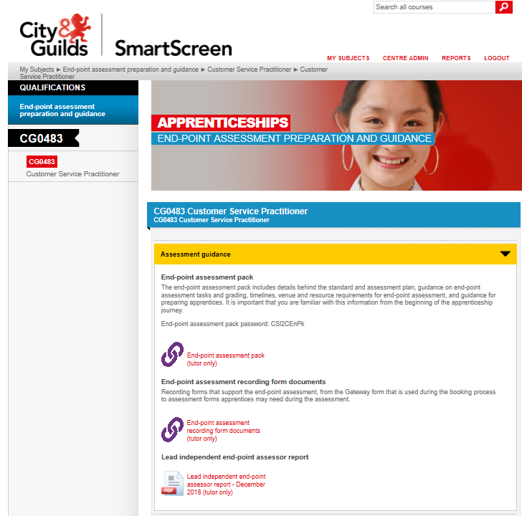
EPA Support Material
End-point assessment pack End-point assessment recording form documents EPA handbooks (if applicable for occupation) Occupation specific FAQs (if applicable for occupation) Resource and venue lists (for some standards) Sample knowledge tests LIEPA report Standard checklists (selected standards)
Notes:
MATT / PAUL
End-point assessment pack : pass word included in SS. The end-point assessment pack includes details behind the standard and assessment plan, guidance on EPA tasks and grading, timelines, venue and resource requirements for EPA and guidance for preparing apprentices. It is important that you are familiar with this information from the beginning of the apprenticeship journey.
End-point assessment recording form documents Recording forms must be used and completed as part of the EPA booking process eg gateway declaration and evidence reference form. Guidance on how to complete the forms is included.
EPA handbooks (if applicable for occupation) The handbook provides more detail behind the units in the standard and the range for the standard.
Occupation specific FAQs (if applicable for occupation) To support your preparation for gateway and the EPA booking, a list of FAQS from customers on this standard.
Resource and venue lists (for some standards) This document details the specific resources required for this EPA.
Sample knowledge tests A sample of the EPA assessment paper to use with apprentices for formative or mock papers. The pack includes the paper, the mark scheme and a mark sheet.
LIEPA report Our lead independent end assessors (LIEPAs) produce an annual report with insight into the EPA results and findings across all centres. These reports can help you refine your apprenticeship delivery to improve success rates.
Standard checklists (selected standards) A user-friend checklist to ensure you and your apprentice are ready for EPA.

Slide 7
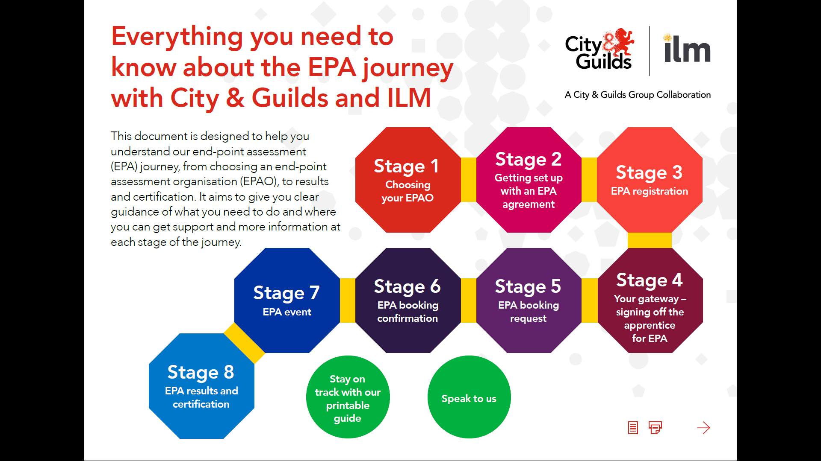

Slide 8
EPA – The Challenges

Slide 9
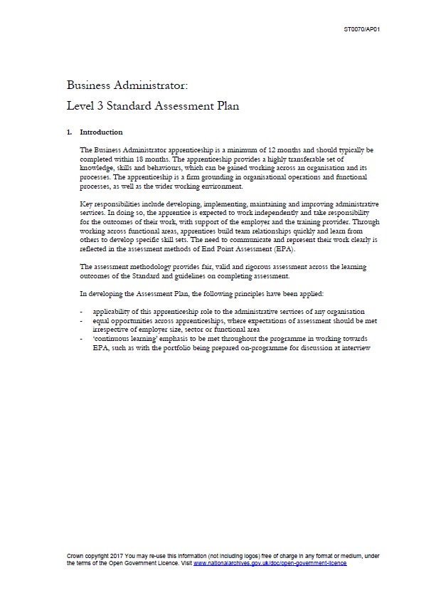
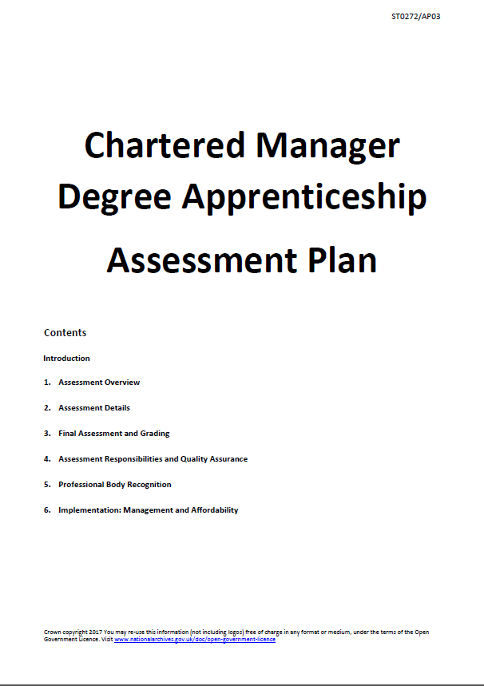

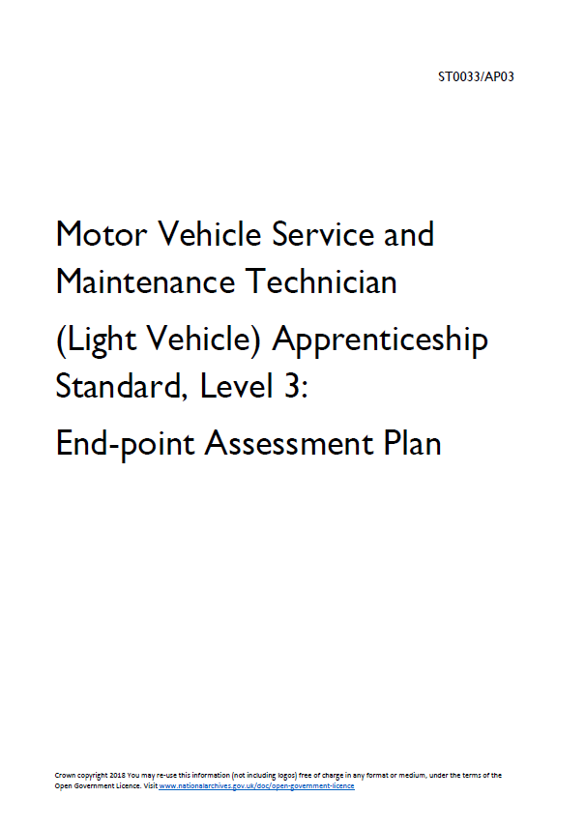
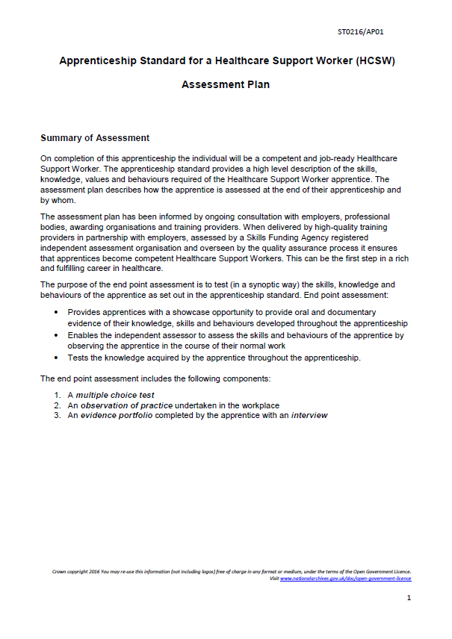
Start with the assessment plan

Slide 10
Start with the assessment plan
It sets out everything the apprentice needs to cover
Outlines the sequence of EPA components
Sets out the expectation of employers and their role

Slide 11

Portfolios
What is a showcase?
How much evidence is required?
When does the evidence need to be collated?
Does it underpin other components of the EPA?

Slide 12

On the day
Are the apprentices prepared?
Are the employers prepared?
If there is an observation is there the opportunity to cover everything?
x

Slide 13
Preparation
Don’t underestimate the difficultly of the EPA and the challenge of its logistics.
Contact your EPAO early and keep in regular contact
Allow enough time to prepare both yourself and the apprentice for EPA

Slide 15
Your experience

Slide 16
Speak to us
Email our Sales Team at
directsales@cityandguilds.com
or call
01924 206709
Notes:
E: directsales@cityandguilds.com.com
T: 01924 206 709

