Slide 1
Setting up for EPA
Level 2 Carpentry and Joinery
9078-21
April 2022

Slide 2
Introduction
This presentation provides an overview of the resources you will need to carry out Carpentry and Joinery EPAs with City & Guilds
We know that every training centre is unique, so this guide is intended to give an overall impression, not hard and fast rules on how to set up your EPA area
More details are available, please speak to the City & Guilds representative for your centre to find out how you can access detailed instructions and technical advice

Slide 3
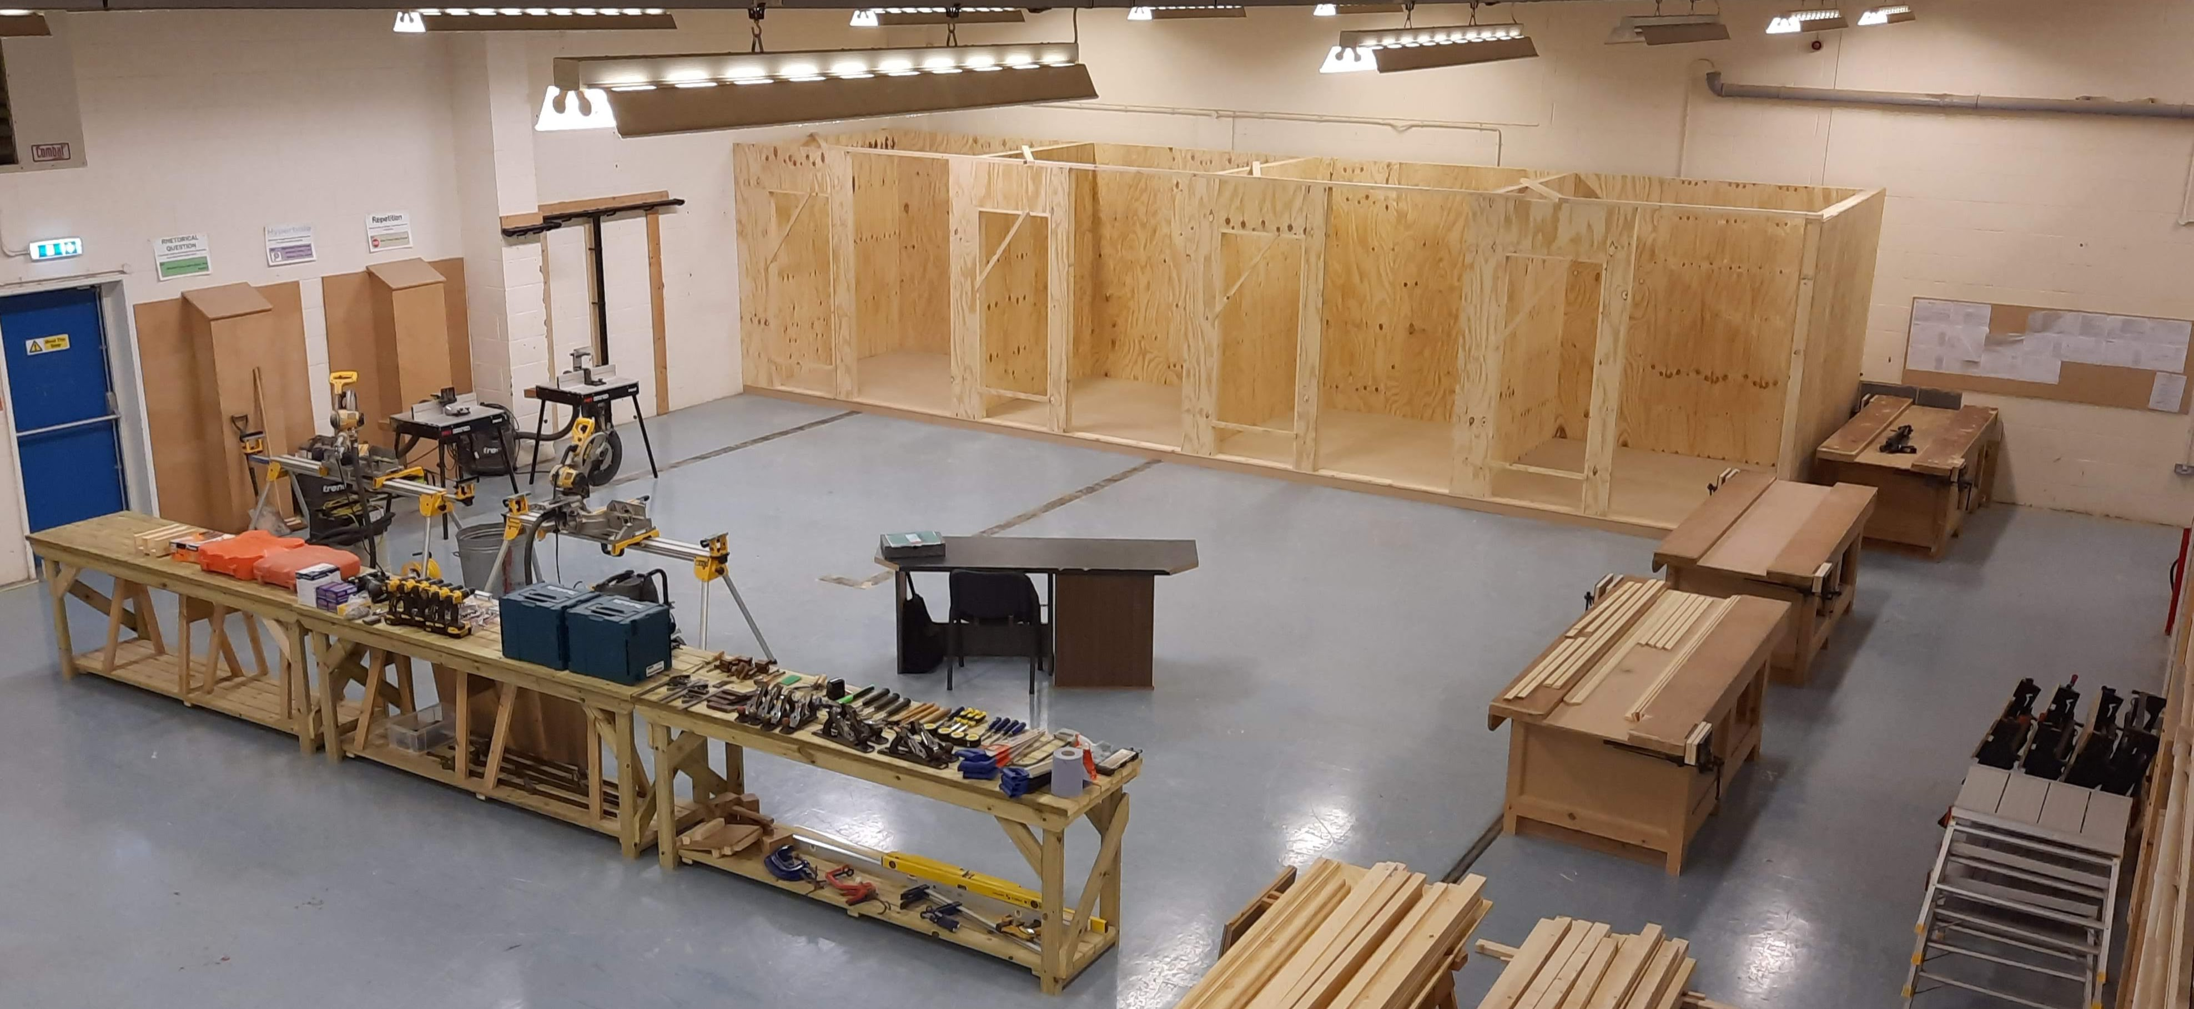
General arrangements
Typical set up for a large centre with space for four bays, this arrangement could be scaled down for smaller workshops, please note some key points…
All bays are clearly visible from the assessor’s desk
There is plenty of work-space in front of the bays
Tools and materials are easily accessible

Slide 4
General arrangements
If you intend to carry out Architectural Joinery EPAs you will also need access to a suitable wood-machine shop
This must be adjacent (or very close) to the assessment bays
Please see further guidance on Architectural Joinery EPAs which you will find on subsequent slides

Slide 5
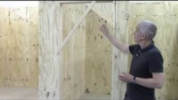
Assessment bays…

Slide 6
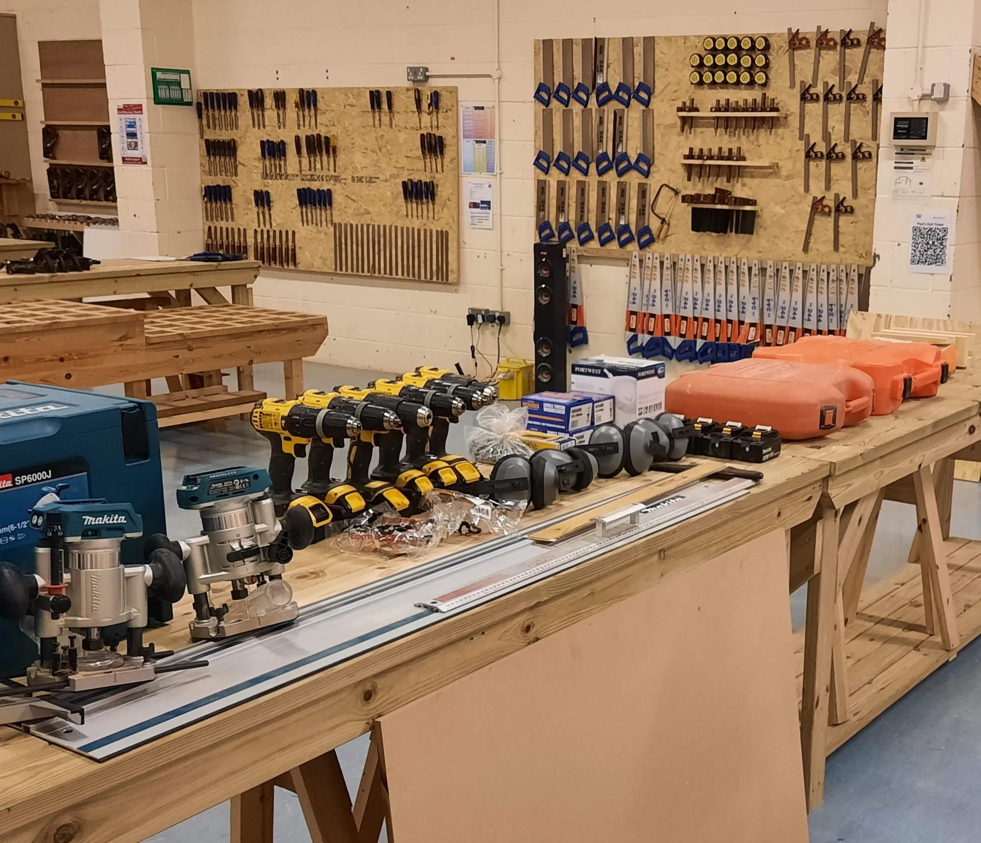
Hand tools
Hand tools and portable power tools must be as described in your resource guide, everything required for the EPA must be ready before the assessment begins
Key Points…
All power tools, including nail guns should be tested before the EPA starts
All guards, accessories and tooling MUST be in good condition
Appropriate PPE should be provided

Slide 7
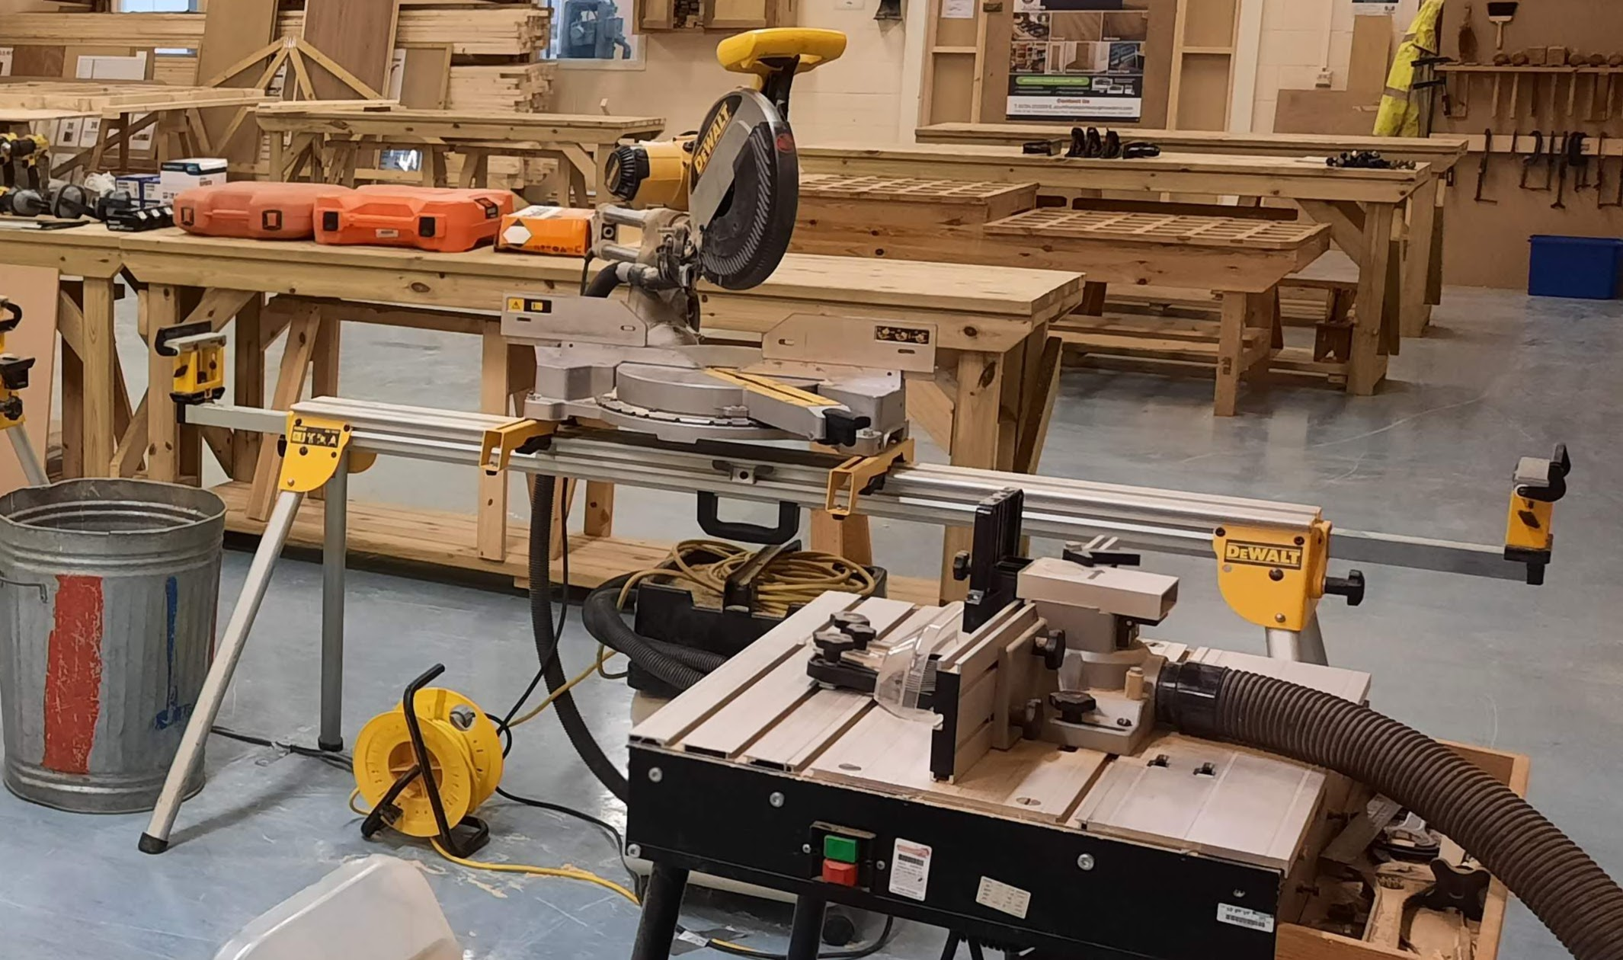
Power tools
For Site Carpentry EPAs we recommend that you provide one chopsaw and one router table for every two candidates. These should be connected to LEV (Other power tools should also be equipped with LEV or a dust bag)
Key Points…
All guards, fences, adjusters and tooling should be in excellent condition
Cables should be safe and tidy
Bins should be provided for scrap

Slide 8
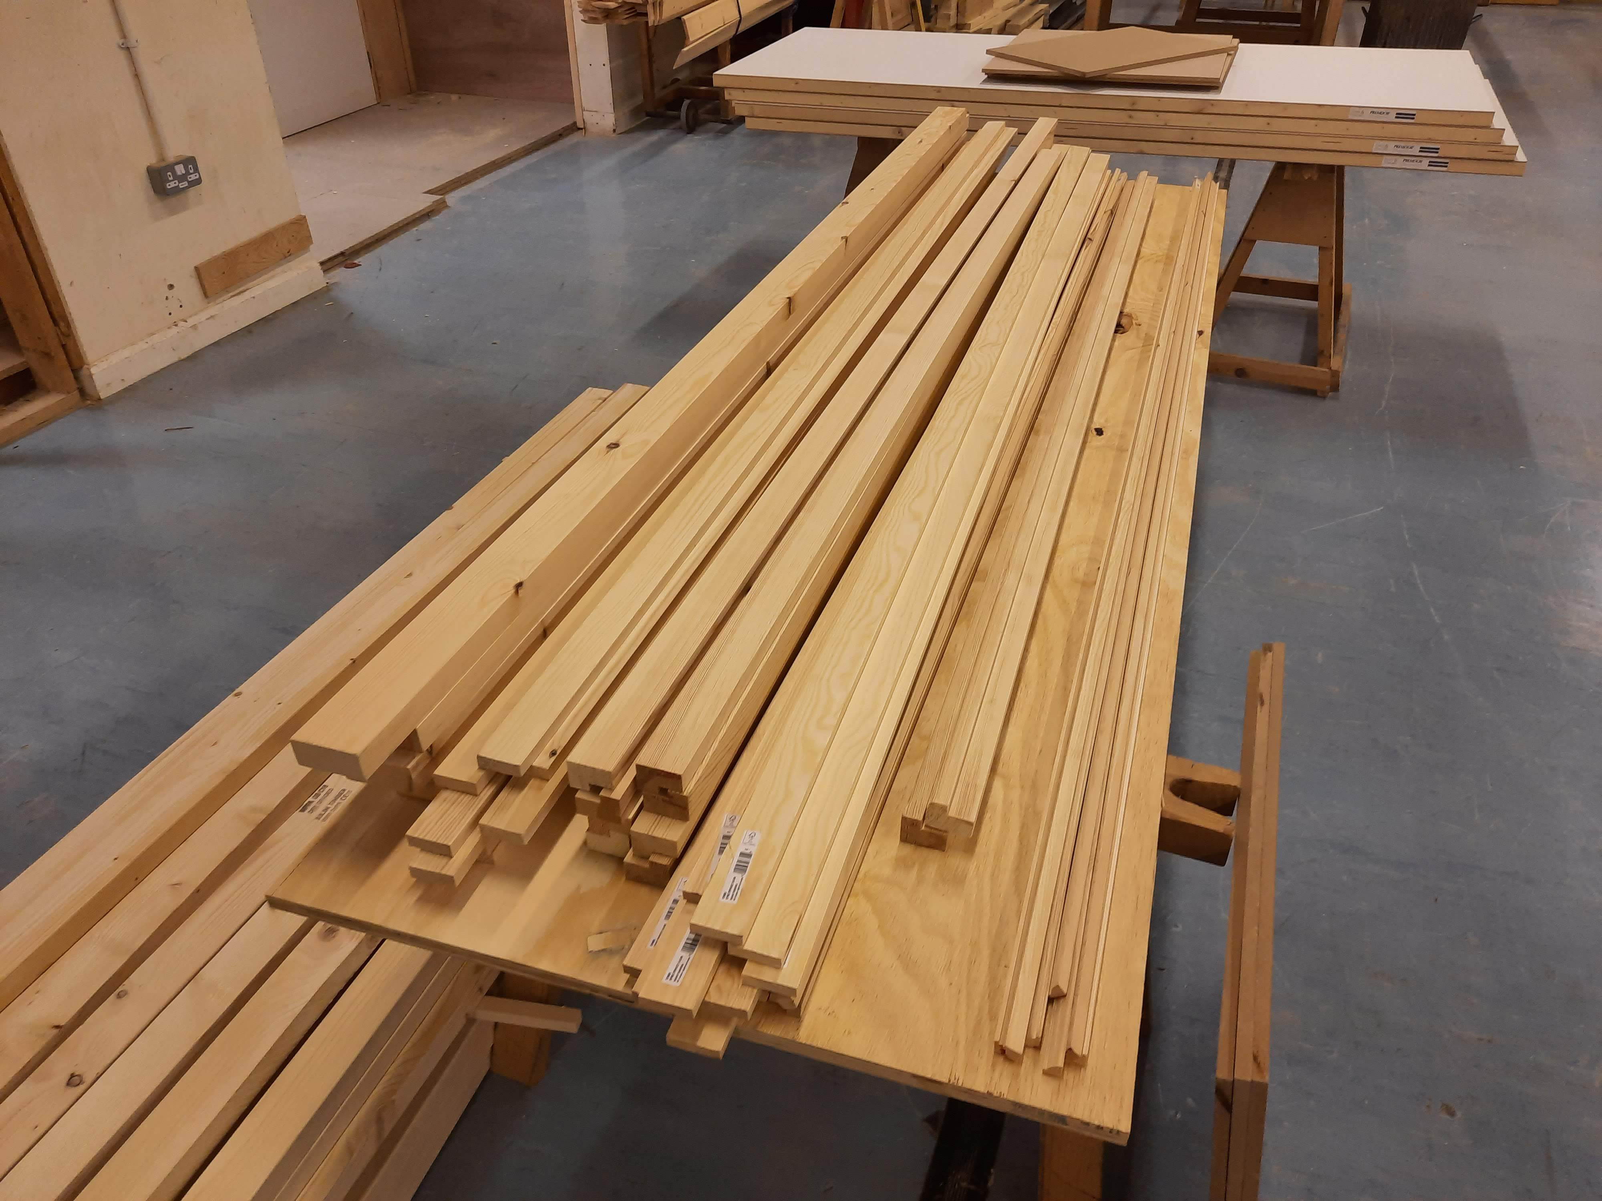
Materials
All the materials required for the whole day MUST be ready before the assessment can start. They should be in good condition and easily accessible
Key Points…
Always allow extra materials in case the candidate makes mistakes
Always check timber sections for warpage or damage well in advance of the assessment
It is good practice to label components and sort into bundles for each candidate

Slide 9
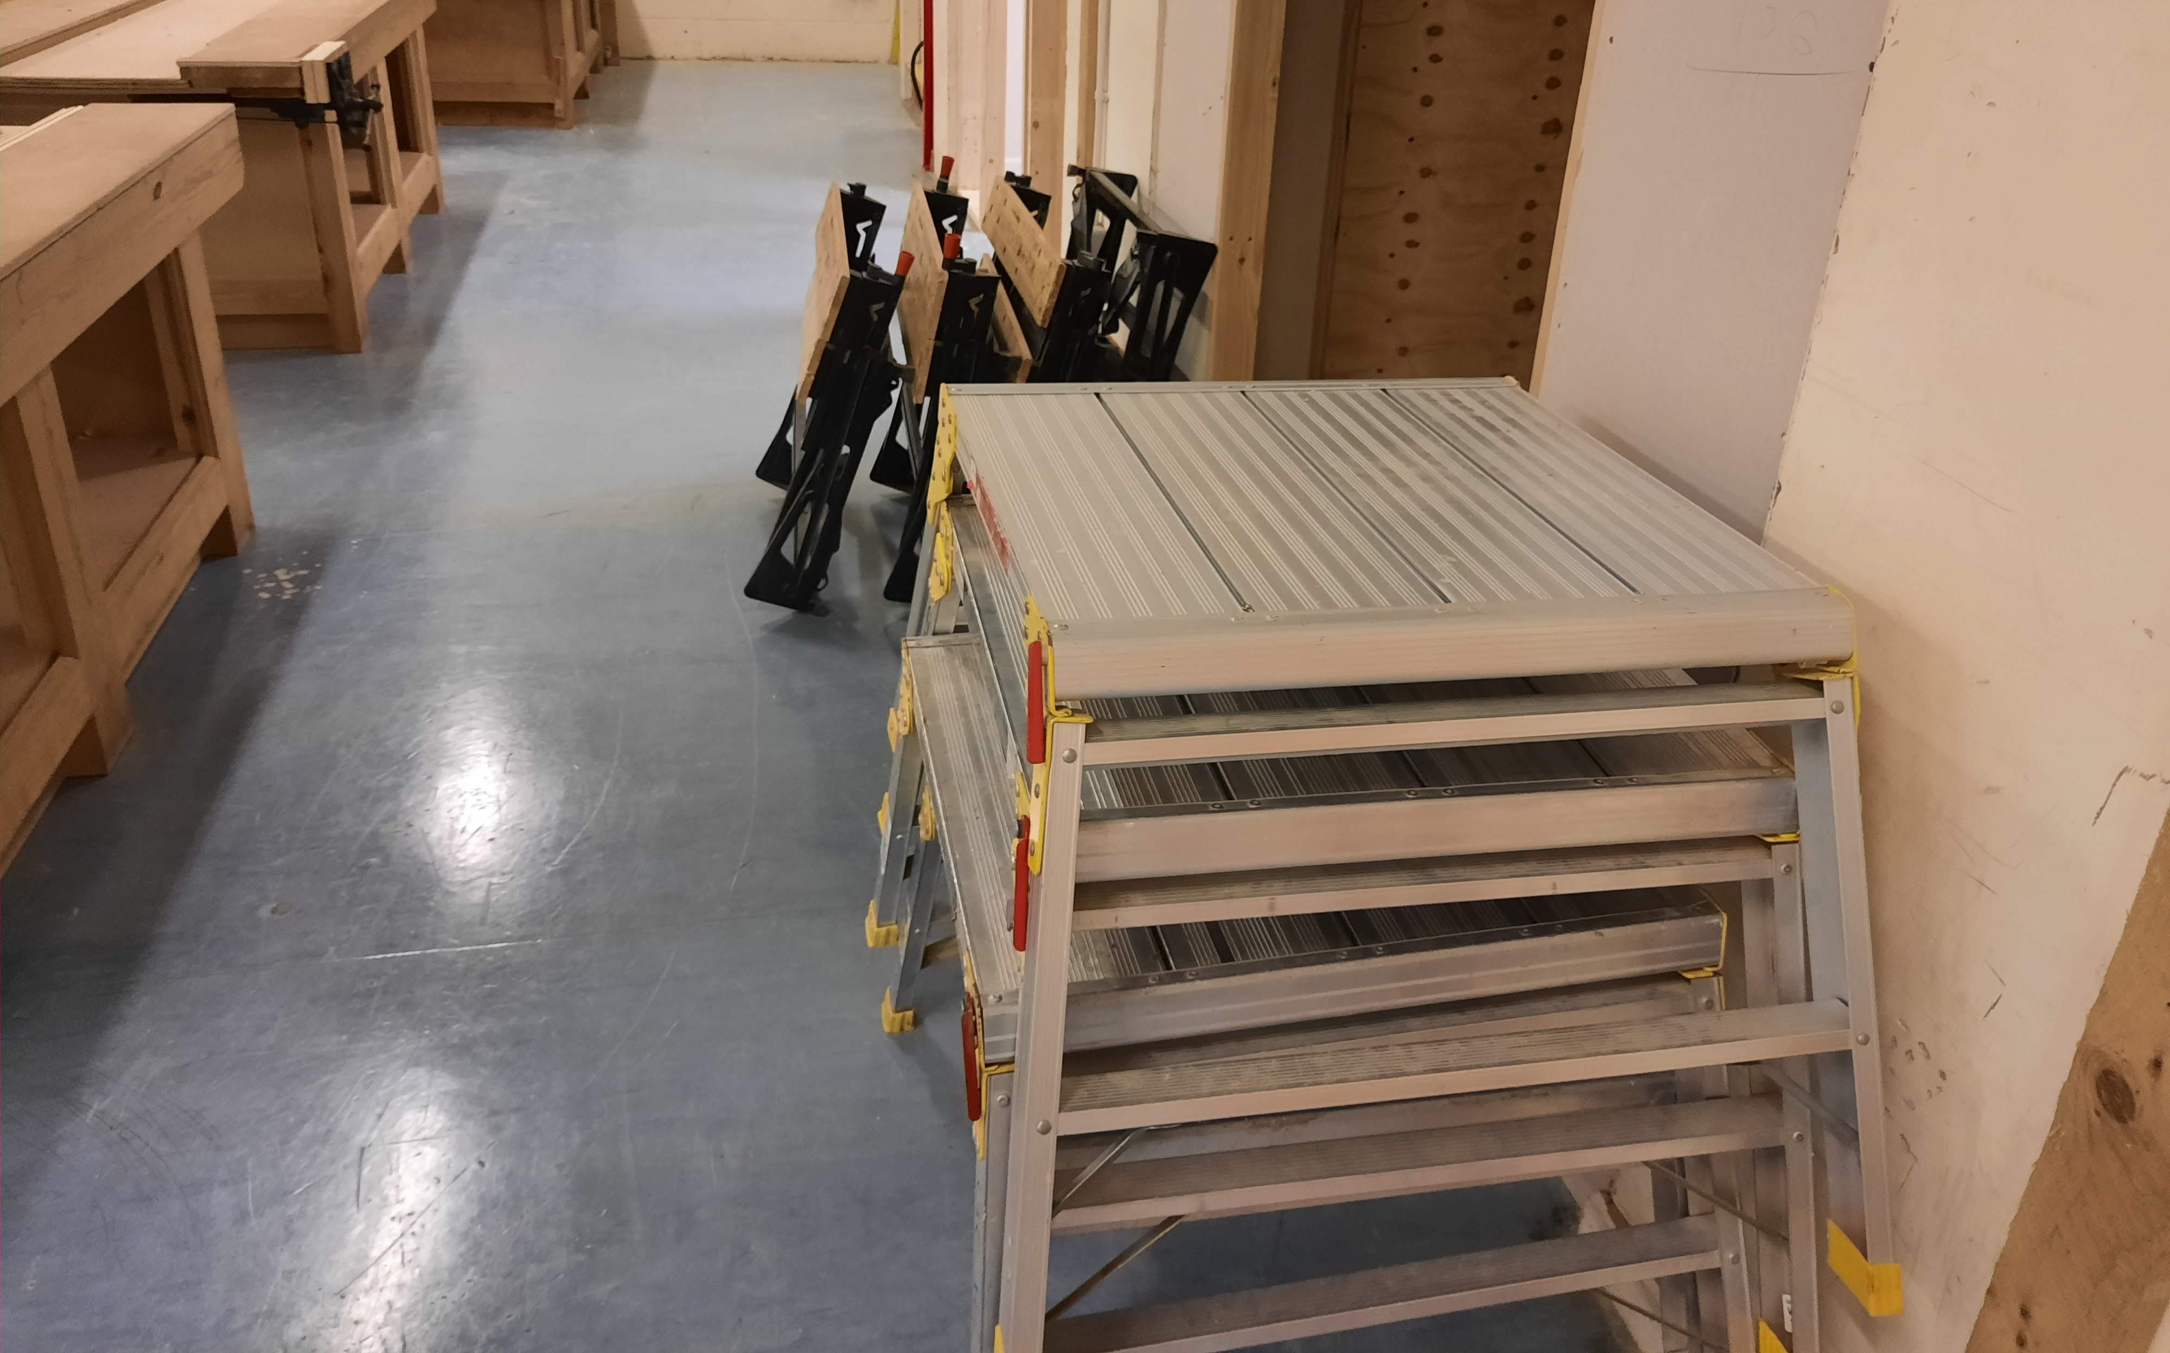
Benches
You will need…
A light desk and chair to be placed in the bay for written exercises (one for each apprentice)
A hop-up/work platform (one between two)
A carpentry bench with vice (one for each apprentice)
A working platform or sacrificial bench-topper suitable for using a tracksaw/railsaw or hand held circular saw to cut small panels safely and accurately (one between two)

Slide 10
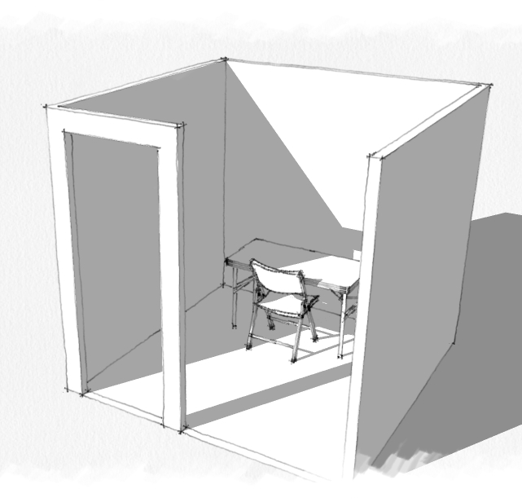
Task 1: Site Carpentry set-up
The candidate will need a suitable desk, calculator and writing equipment.
If more than one candidate is taking the EPA, they will need to be separated, ideally a lightweight desk will be placed in the EPA bay, then removed for later tasks

Slide 11
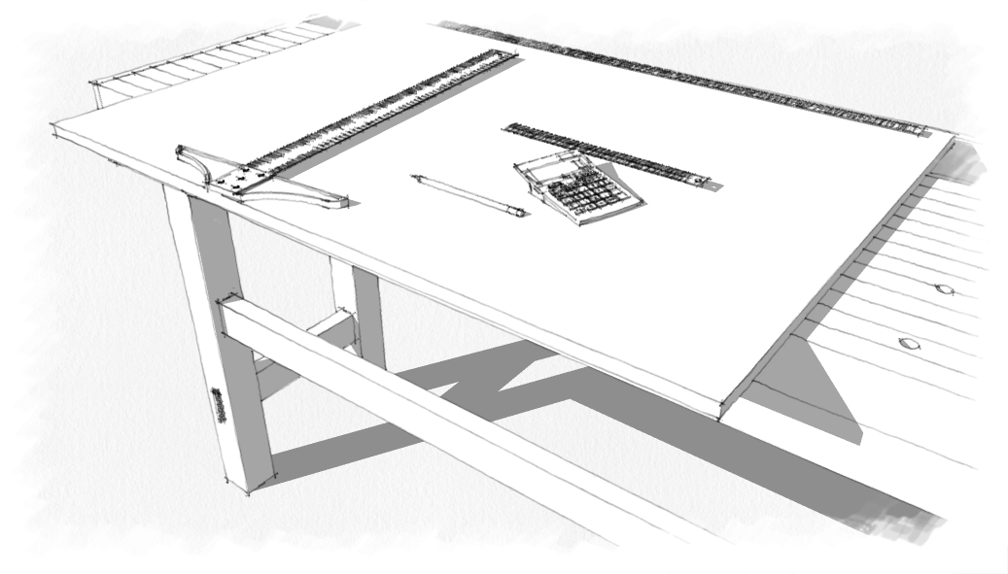
Task 1: Architectural Joinery set up
Candidates are expected work to tight tolerances and so the drawing equipment you provide should be in excellent condition.
For example the board should be new with clean, square edges and the T-square should be tight and checked for square BEFORE the task begins

Slide 12
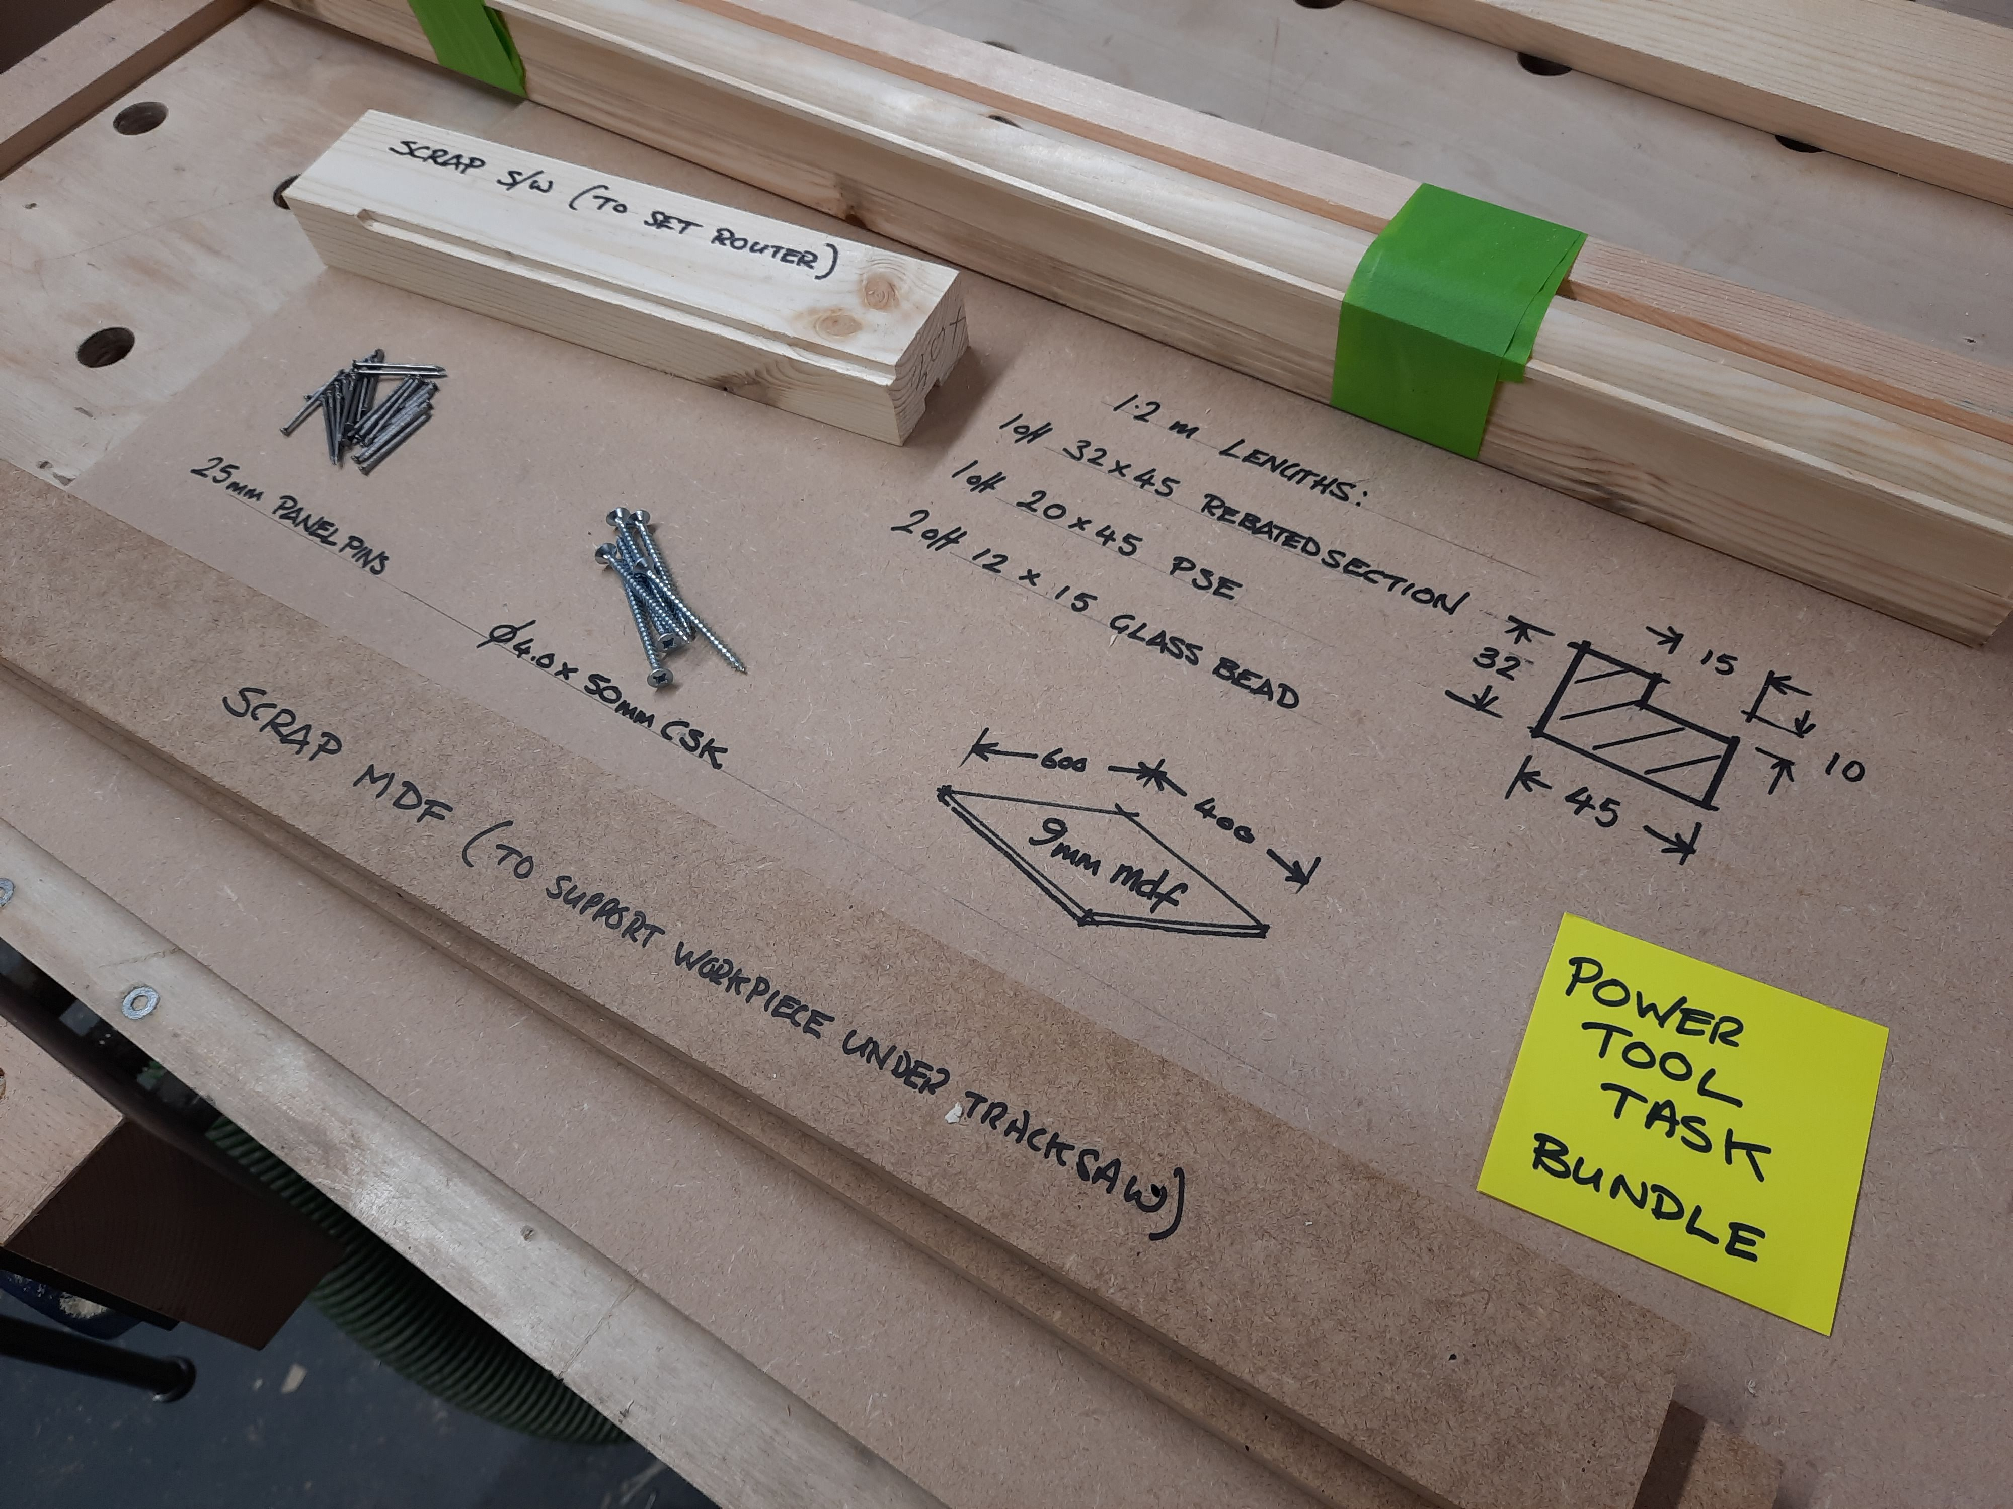
Task 2 (power tools) Resources
N.B. The example shown is for illustrative purposes only, specifics may differ from version to version so always check the latest resource pack
Examples of good practice…
Resources are bundled and clearly labelled for each task
Scrap is provided for router-set up
Sacrificial battens (or similar) are provided to support panels when using a track saw
Timber sections are checked before the task and spare sections are available

Slide 13
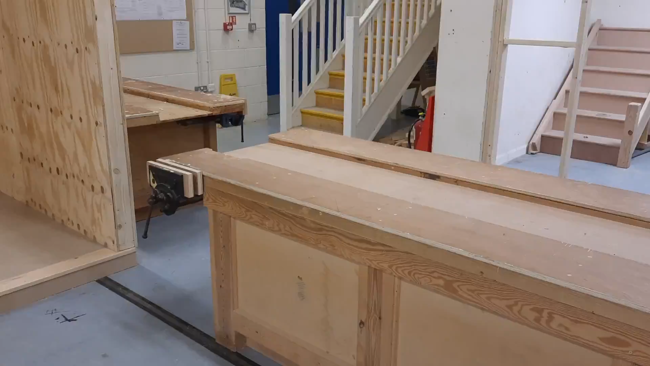
Task 2 (power tools) Bench and work area
The candidates will need a good quality bench for this exercise. This should be near to the power tools they will be using
Please ensure that the bench is suitable for work-support while using the power tools specified (see the list of tools in your resource pack)
Apprentices may need to use routers to profile small timber sections

Slide 14
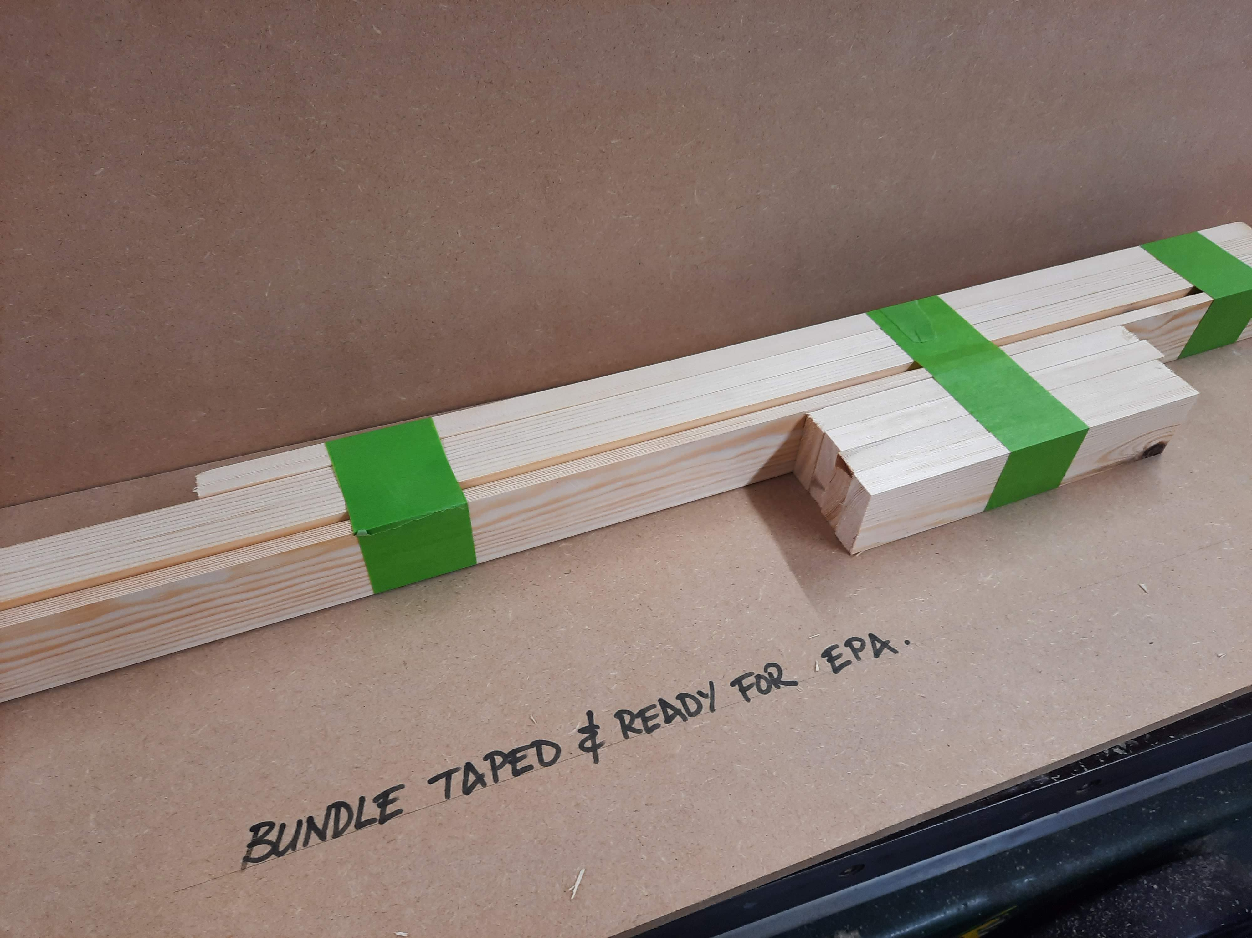
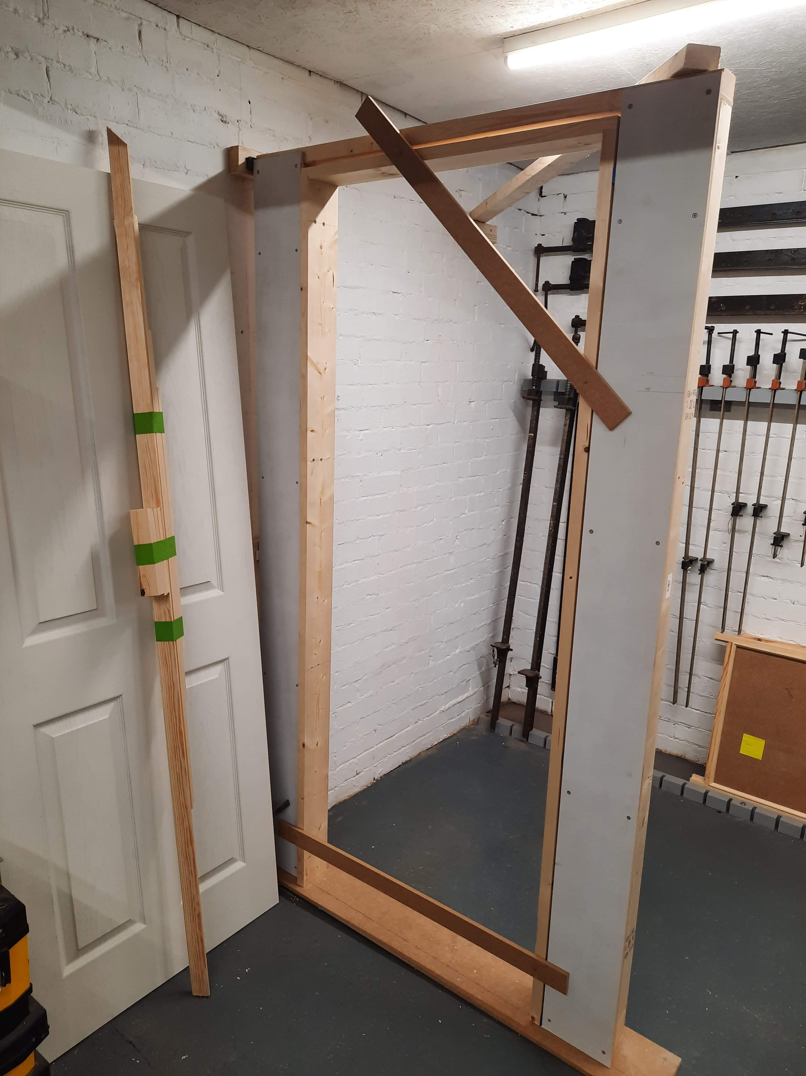
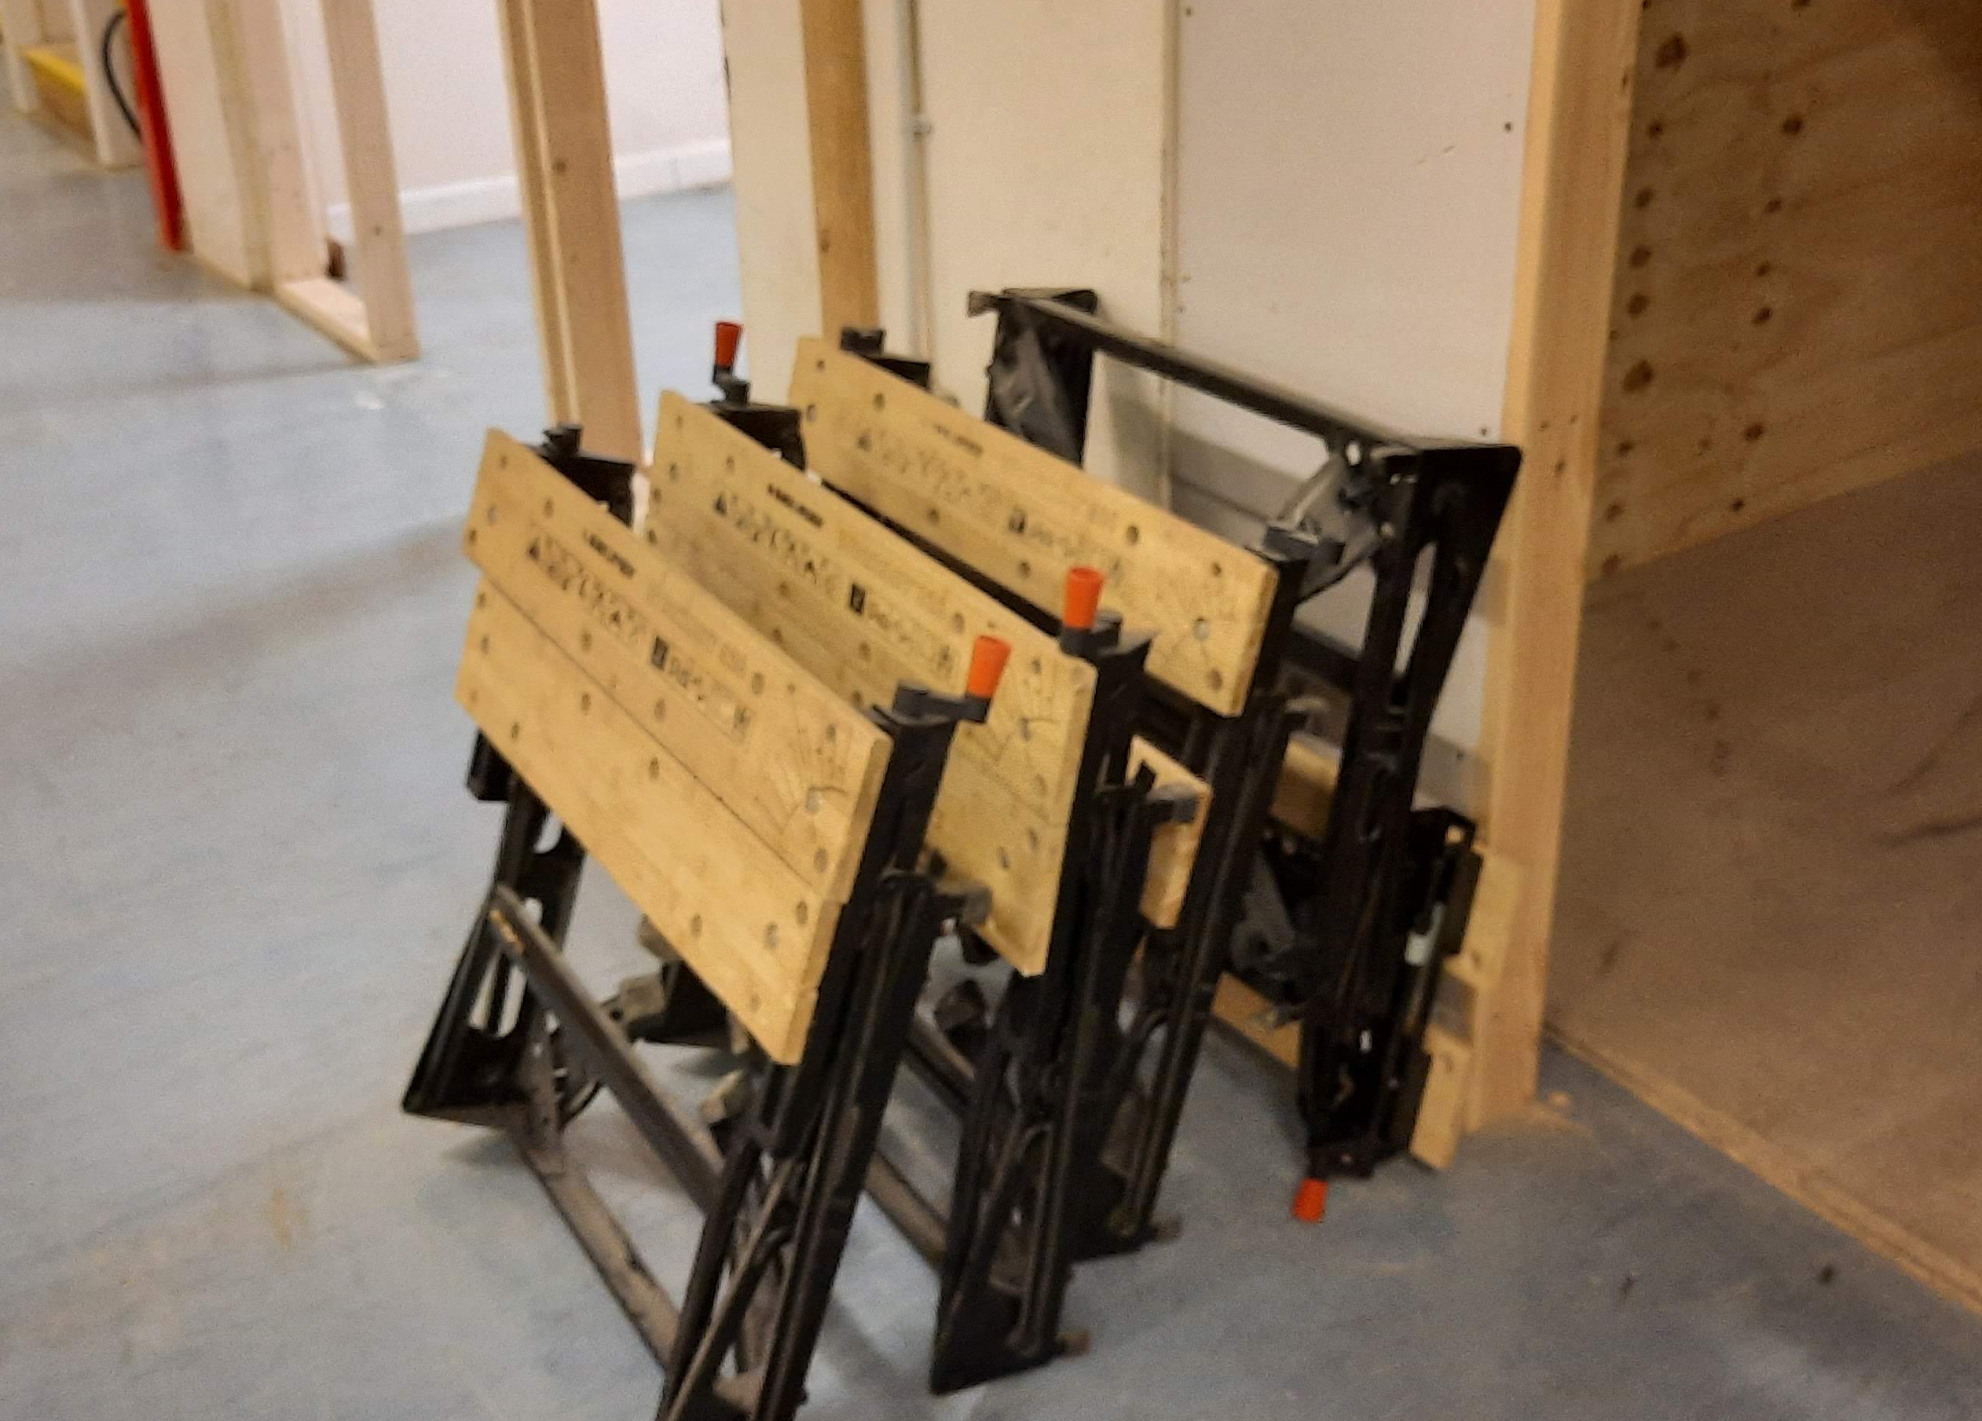
Task 3 (hand tools) Resources
All the materials required for the whole day MUST be ready before the assessment can. Materials should be in good condition. Spare doors may be required for this task
Top tips…
Always check and double check the wall opening and door lining, getting this right will help your candidate to do their best work during the EPA
Bundle and clearly label timber sections, include short lengths for use as temporary door stops
Always provide good quality hinges and screws
Portable benches and hop-ups are often useful

Slide 15
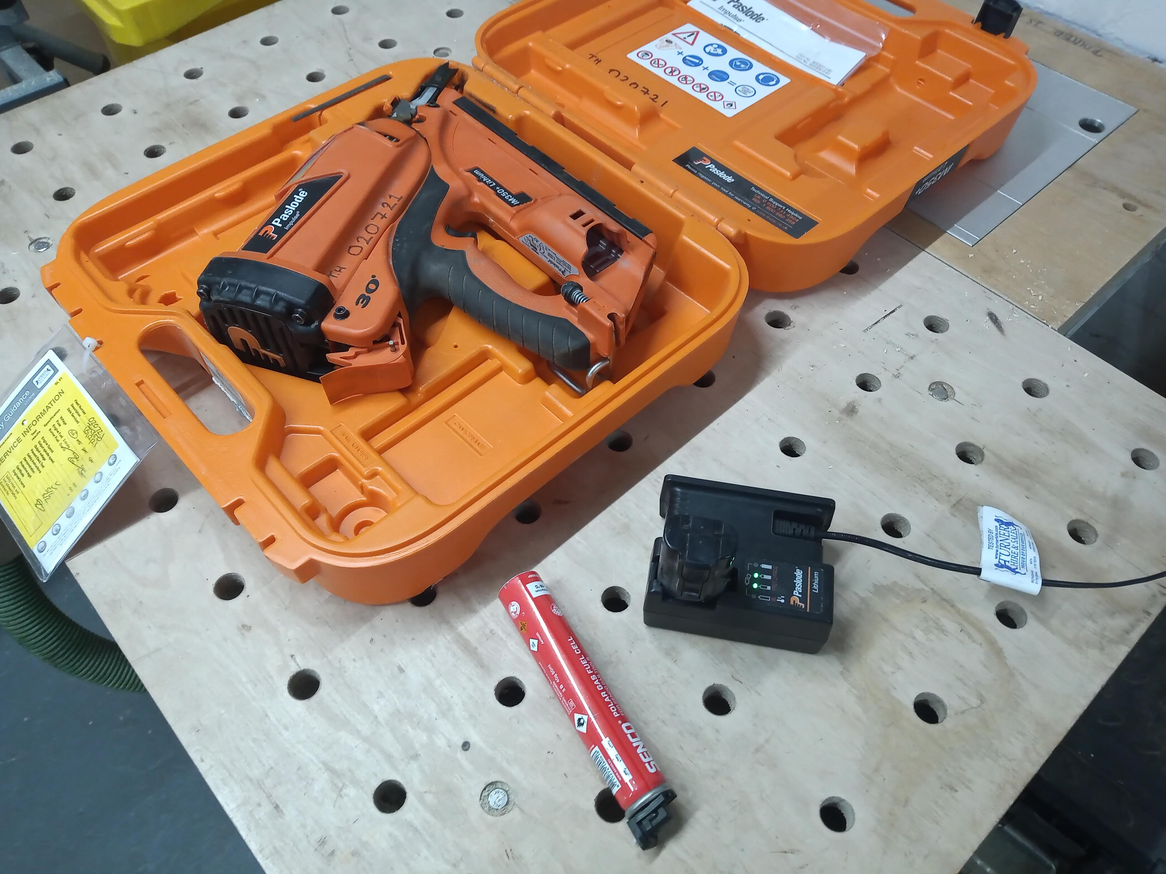
Task 4 Site Carpentry set up
This task involves making a cls frame and fitting it in the assessment bay. A suitable framing nail gun should be provided. The candidate will need sufficient floor space to build the wall OUTSIDE of the bay
Every candidate must be adequately trained in the safe use of nail guns, the task will be stopped immediately if unsafe practice is observed
Top tips…
If you are using a gas+battery nail gun, make sure that the gas is stored at the correct temperature and the battery is fully charged. ALWAYS test the gun before the task begins
Air or battery powered nail guns are perfectly acceptable for this task
Screws may be used wherever using the nail gun seems unsafe, suitable screws should be provided

Slide 16
Task 4 Architectural Joinery set up
Some points to consider when preparing for 9078/9-21
Architectural Joinery (AJ) EPAs:
Although a cohort booking of up to 4 apprentices is possible , the number of AJ apprentices that can be assessed at any one time at your venue will depend on your workshop set up, think about the space and machinery you have available before booking a cohort
Ask yourself, how many apprentices can safely work in this space using this machinery without excessive waiting time?
We recommend a ratio of 1 piece of essential equipment for each two apprentices; please review the equipment list on the next 2 slides
The machine shop MUST be adjacent (or very close to) the assessment bays

Slide 17
Task 4 Architectural Joinery set up
Some guidance on fixed machinery:
Table saw:
Candidates will need to rip sawn timber to rough dimensions and cut small panels accurately to correct size/angle. Suitable blades must be provided (these can be changed by the technician during the test if necessary) Sliding tables, fences, etc. MUST be in good order and capable of producing clean, accurate cuts.
Planer/thicknesser:
A separate surface planer and thicknesser or a planer-thicknesser must be supplied. This must be in very good working order and of industrial quality. Tooling, extraction, guards, etc. must be in very good order.
Bandsaw:
As with all tools and machinery, this should be industrial quality and in very good working order, the candidate should not have to replace blades, adjust guides, etc., or need to wait for long periods while running repairs are carried out
Morticer:
Should be in good order and a suitable chisel fitted. Any tool changes should be carried out by the centre technician.

Slide 18
Task 4 Architectural Joinery set up
Some guidance on portable power tools:
Biscuit jointer:
A suitable biscuit jointer should be provided, candidates must be familiar with this tool
Dowelling jig:
A good quality dowelling jig and dowels should also be provided.
Mitre saw:
This must have a depth stop to allow trenching and a sharp blade suitable for fine work

Slide 19
After the EPA
All of the candidate’s work should be dismantled as soon as possible after the EPA
Any drawings or rods should be destroyed, erased or over-painted
Any setting out on the assessment bay walls or floor should be erased or over-painted

Slide 20
Help and advice
Independent End Point Assessors are not authorised to advise you on how to set up for EPAs, this is seen to be in direct conflict with their independent status.
If you need more information on EPAs in general or have suggestions as to how we can improve our service, please contact your designated City & Guilds contact or email centresupport@cityandguilds.com
For standard specific technical support, please contact:
Jason Howe Jason.Howe@cityandguilds.com
Paul Brown Paul.Brown@cityandguilds.com
For help with the EPA process and bookings, please contact:
EPA@cityandguilds.com

Slide 21
Thank you

