Slide 1
Apply professional workplace standards
PowerPoint presentation
Unit 205: Professional workplace standards

Slide 2
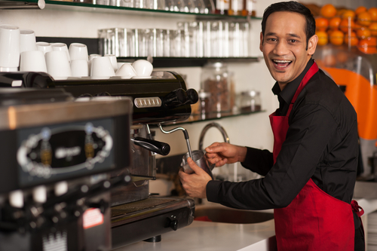
Introduction
Working within the hospitality industry can be extremely rewarding. A career in hospitality is both vast and demanding.
Those working within hospitality must be constantly adapting to change, placing the needs of the customer at the forefront of every decision.
Whether you like cooking, waiting, planning or hosting – in order to be employable within the hospitality industry, there are some of the essential skills that are a must.

Slide 3
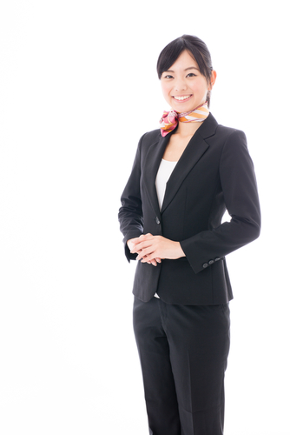
Professional personal appearance
First impressions can colour the guest’s perception. Once the perception is formed, even if it is faulty, it is very hard to change.
You only get one chance for a good first impression.
Personal hygiene standards are essential for all staff to maintain a clean and odor free experience when dealing with colleagues and guests, showing that pride is taken in one's own appearance as well as reducing risks of contamination and guest safety. Personal hygiene includes:
regular bathing/ showers
dental hygiene
grooming of hair
grooming of nails
deodorants/perfumes.

Slide 4
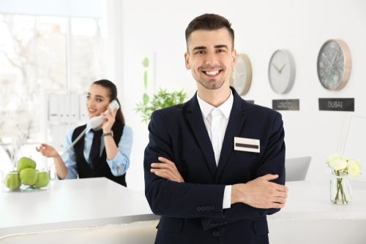
Professional personal appearance
Appearance/grooming
It is important to both look clean and presentable. Management should make sure all employees know the dress code and provide them with a clear outline of what is expected. Guidelines for both men and women that dictate appropriate uniforms, hairstyles, accessories and shoes, considerations also include:
wearing of jewellery
use of nail polish or specific colours
appropriate amount of make-up.

Slide 5
Professional personal appearance
Behaviour – although physical appearance of hotel staff helps to maintain their overall appearance, the way they act also contributes to the hotel’s reputation.
Employees should be encouraged to report for duty 5–10 minutes before their shift starts and to always treat guests with respect.
Codes of conduct for employees sets out the standards of behaviour expected from employees as well as guidelines to handle different situations, including :
reputation
conduct
loyalty
ethics
honesty
Confidentiality.

Slide 6
Professional approach
Polite – communication and interactions with both guests and co workers must be respectful and polite, whilst keeping an open mind and consideration of both cultural and language differences.
Punctual – employees are expected to be punctual and dependable in order to meet the needs of their department and workplace. When employees are absent or late, work and service are interrupted, and an additional burden is placed on work colleagues. Punctuality is one of the important factors in evaluating individual performance and continued employment.
Helpful – being helpful or going beyond expectations enhances both guest and work colleague experiences, creating an atmosphere that contributes to business success.

Slide 7
Professional approach
Professional attitude – while having high quality skills is vital, if someone has a poor or negative attitude, there is no doubt that they will struggle to interact with people and craft a successful career in the service sector. Essential attitude can be divided into two distinct areas:
Thoughts: The core of your attitude starts with your thinking around how you approach the world, relationships, work and other areas of life.
Actions: Based on how positive you are, this translates into your behaviour towards people, environment and situations.
A person with a good attitude is a pleasure to be around and that's good for your customers and co-workers alike.

Slide 8
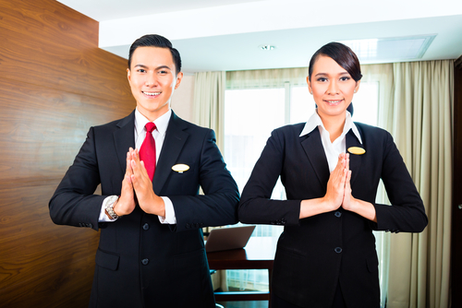
Professional approach
Guest etiquette in the hospitality industry is crucial to helping guests feel comfortable. Knowing how to treat guests with courtesy and respect makes them feel safe. It is an accepted standard of good behaviour when at work, treating people with kindness and making the guests feel important; not just to make a quick sale, but to build a relationship as well as meeting their expectations.
Addressing people by their name, not being overly familiar and communicating in an appropriate manner all contribute to guest etiquette.

Slide 9
Any questions?

