Slide 1
Understand the application and monitoring of food safety practices
PowerPoint presentation
Unit 306: Monitoring and supervision of food safety

Slide 2
The importance of pest control
Legislative compliance
To avoid contamination (pathogenic bacteria, spoilage bacteria)
To avoid spread of disease
To avoid loss of reputation and profit
To prevent drop in staff morale
To avoid damage and wastage of food.

Slide 3
Methods of pest control
Staff training and awareness
Engagement of a pest control contractor
Path around food business buildings for ease of detection
Keeping areas surrounding the business clean and tidy
Pest proofing - traps, poisons, pesticides, fly screens, fly traps, electronic fly killers
Waste management.

Slide 4
Staff training and awareness
Staff need to be aware of pest contaminants can be taken into food premises and ingredients
Prompt removal of waste and not leaving overnight may attract types of pests.

Slide 5
The importance of pest control
Engagement of a pest control contractor
Pest control contractors should inspect premises inside and out on a regular basis.
Contractors can provide specialist equipment and chemicals and recommend additional methods to reduce the likelihood of a pest infestation.
Premises should be well lit and free of rubbish to prevent attracting rodents. There should be a path around food business buildings for ease of detection.

Slide 6
The importance of pest control
Keep areas surrounding the business clean and tidy:
Outside waste bin areas and bins should be kept secured with tight fitting lids.
Remove unused equipment, vegetation and other harbour areas from outside areas.

Slide 7
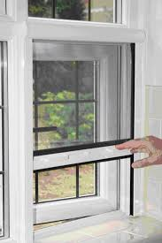
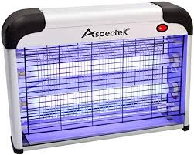
Preventative measures
Pest proofing: Traps, poisons, pesticides, fly screens, fly traps, electronic fly killers.
Notes:
Source - https://www.google.com/url?sa=i&source=images&cd=&cad=rja&uact=8&ved=0ahUKEwjUybyznavnAhWqWhUIHSjGChQQMwjlASgtMC0&url=https%3A%2F%2Fwww.pinterest.com%2Fpin%2F335588609712105486%2F&psig=AOvVaw3hmTU44kgOpv7gpzjqLmyC&ust=1580470459708775&ictx=3&uact=3
https://www.google.com/url?sa=i&source=images&cd=&cad=rja&uact=8&ved=0ahUKEwizl_LSnavnAhUlpnEKHTjdA0EQMwj6ASgAMAA&url=https%3A%2F%2Fwww.amazon.co.uk%2FAspectek-Attract-Insects-Playing-Excellent%2Fdp%2FB017TDXN54&psig=AOvVaw344Q-NDMOt5SMdjA0AyFsd&ust=1580470525195555&ictx=3&uact=3

Slide 8
The importance of pest control
Waste management
All food waste should be removed and disposed of a hygienically and environmentally friendly way in order not to constitute a direct or indirect source of contamination.
Waste bins and areas should be managed to ensure they are kept clean and pest free.

Slide 9
Any questions?

